Slide 1
Welcome To Our Presentation

Slide 2
Group Name “DELTA”

Slide 3
Group Members
Md. Anisur Rahman Rony (162-15-7880)
Abdullah Al Azmi (162-15-7959)

Slide 4
Contents
Topic Name
Dataset
IDE and Environment
Algorithm
Implementation
Accuracy
Conclusion

Slide 5
Topic Name “Online rating for electronic gadgets for commercial purpose”

Slide 6
Datasets
For implementation of our project we have collected negative and positive rating datasets from several different sources.
After that we combined that data into one file.
Finally the data size becomes almost 3000.
This data is similar to dataset for any online rating.
Here is the link of that final dataset:
https://drive.google.com/open?id=1Z_ZKUMEGWWLa_a658v_fKA1anfy72TgW

Slide 7
IDE and Environment
For implementation we used Python, Anaconda Navigator, Jupyter Notebook etc.
As it is online rating our model can be deployed to web.
For deploying online Python Flask can be used.

Slide 8
Algorithm
In our project we used classification algorithm.
Specifically it is Random Forest Classification.
We used this algorithm by importing RandomForestClassifier from sklearn.ensemble.
We have chosen this algorithm because it gives more accuracy than other algorithms.

Slide 9
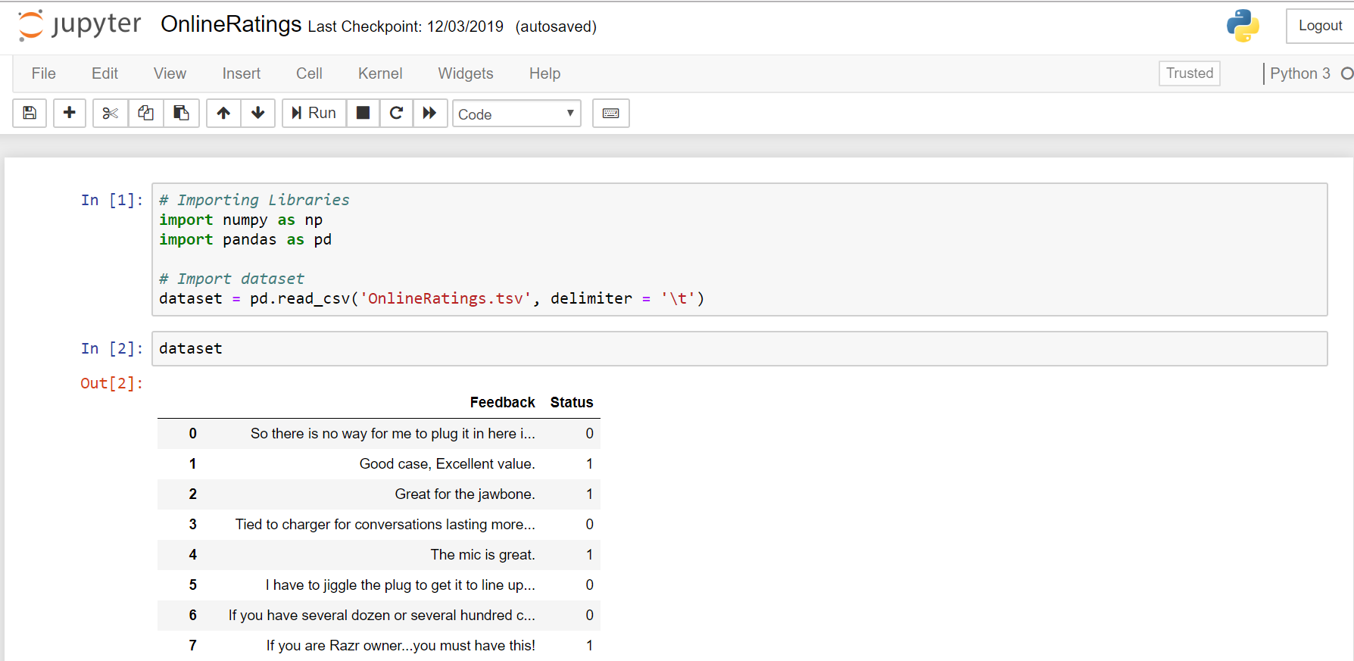
Implementation
Screenshots of Code:

Slide 10
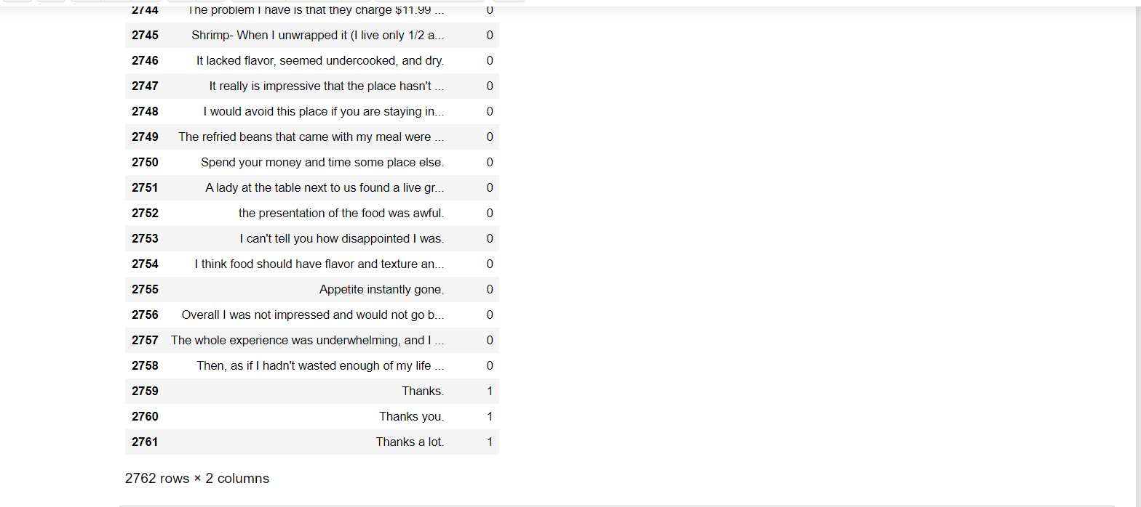
Implementation

Slide 11
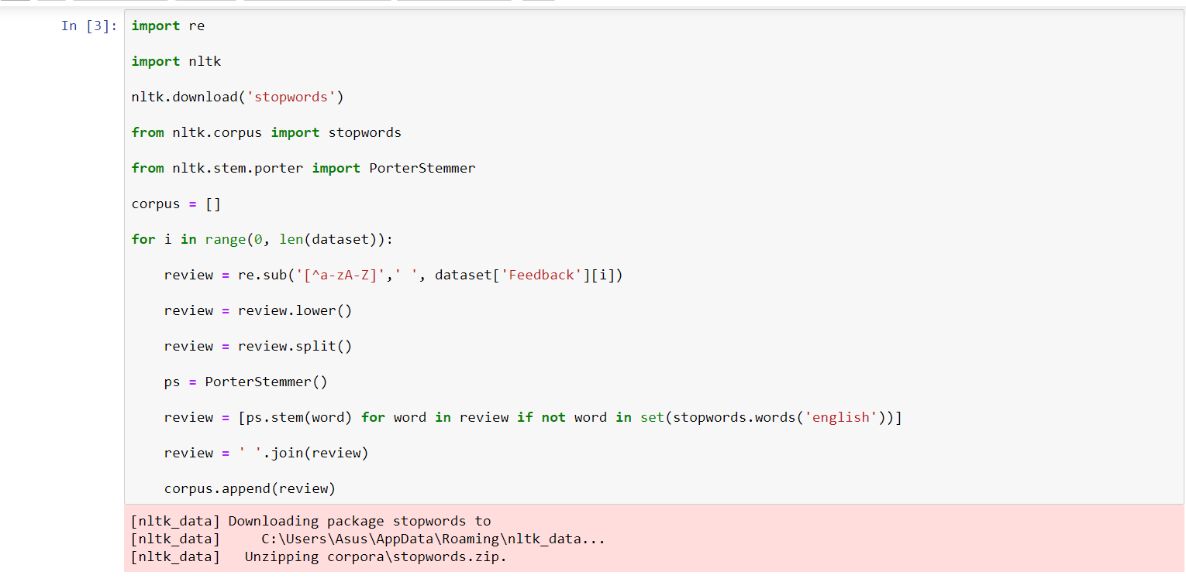
Implementation

Slide 12
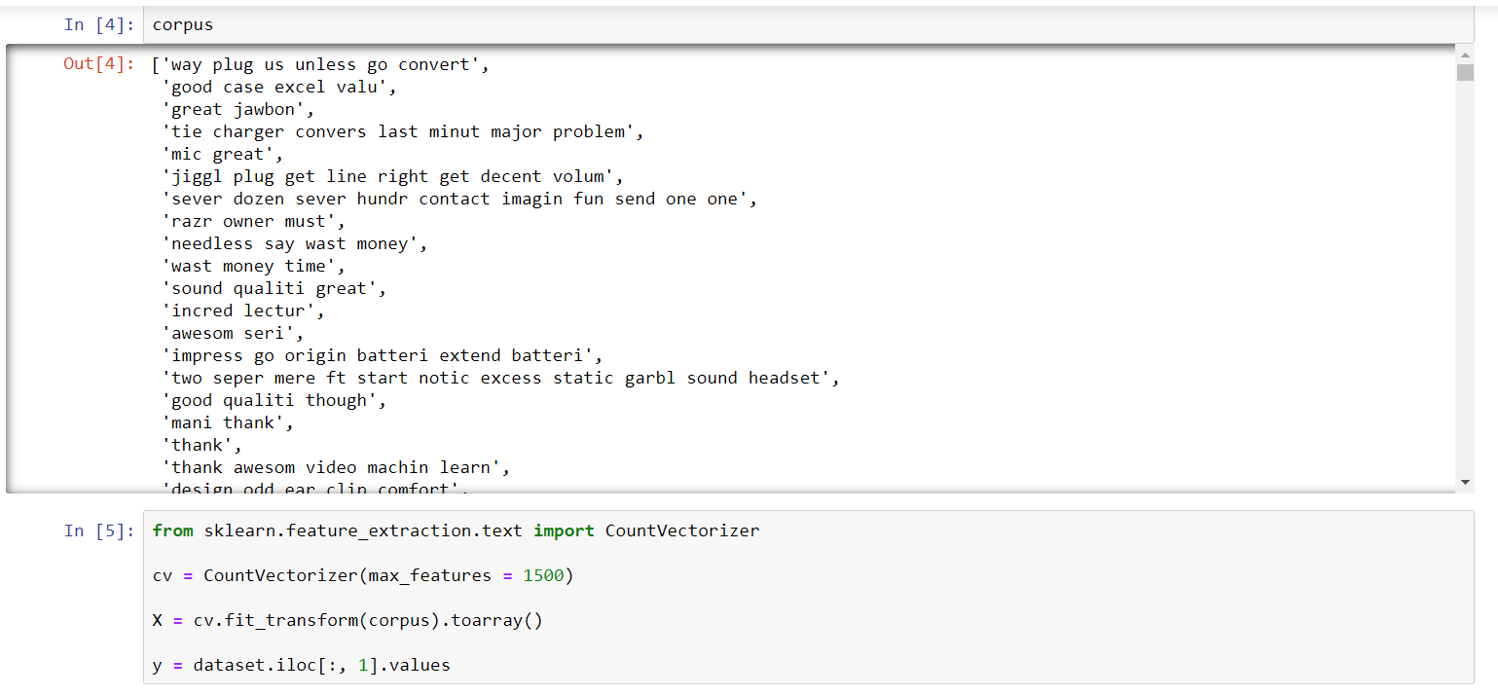
Implementation

Slide 13
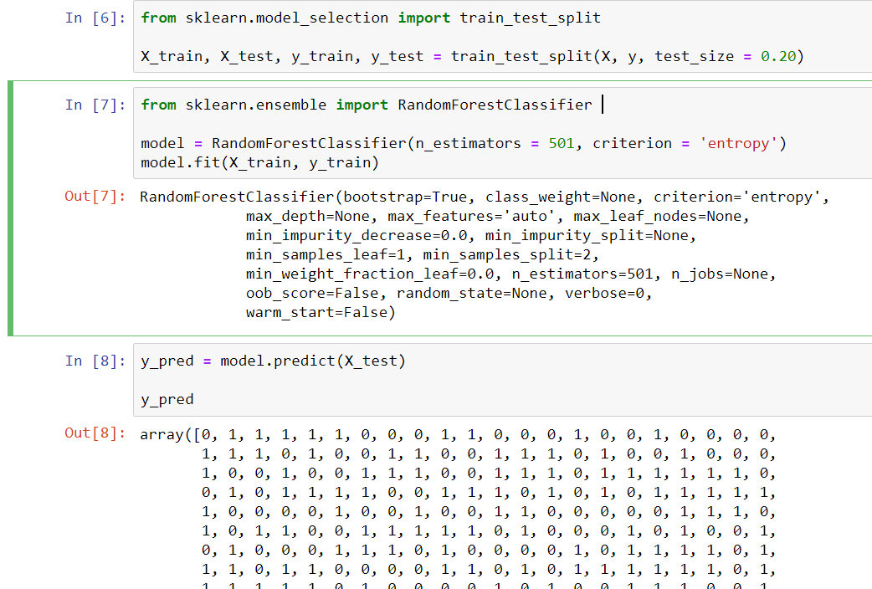
Implementation

Slide 14
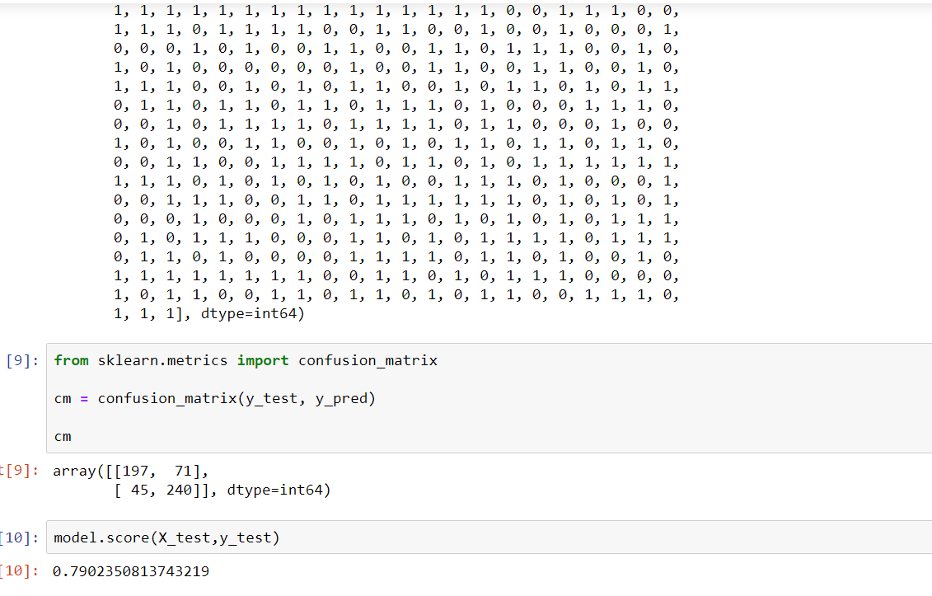
Implementation

Slide 15
Implementation
In the above screenshots whole implementation has been shown.
This is the link of pdf code:
https://drive.google.com/open?id=1MRWVt3JsTCeWZDghwM5IJq0ts-K2QTIy

Slide 16
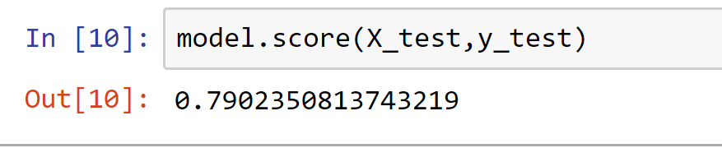
Accuracy
Our model gave almost 80% accuracy.
It is better compared to other algorithms.
Increasing data size increased the accuracy.

Slide 17
Conclusion
Online product rating is very important because it makes great impact in business.
Customer can be recommended for further product.
Positive and negative ratings of products can be analysed for increasing the profit.
Our model implemented above can be helpful in this case.

Slide 18


